Slide 1
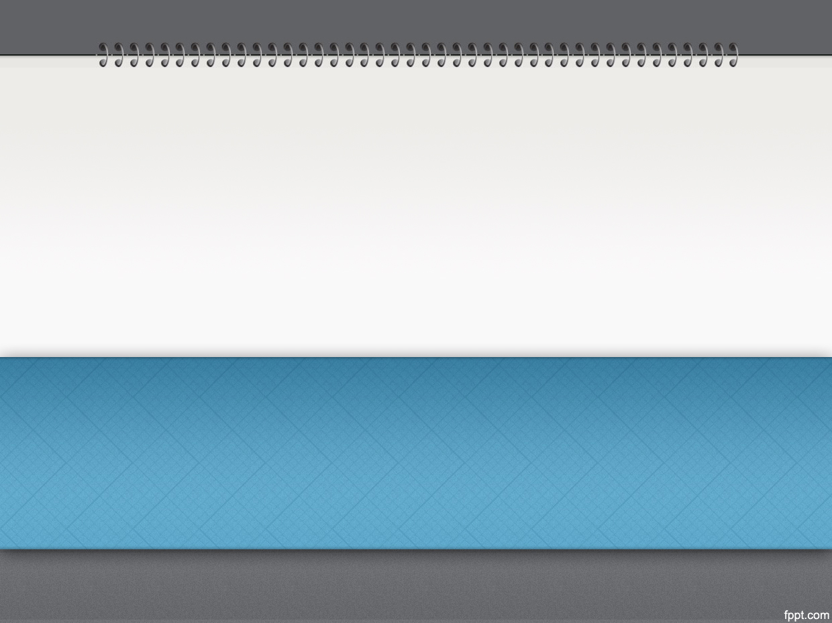
Connections
Your Name
AS90852 - Explain significant connection(s) across texts, using supporting evidence 4 credits

Slide 2
Introduction
List your four texts and authors’ names:
Text 1
Write a sentence stating the main idea or theme that connects your texts. Expand on this idea by saying a bit more about what it means.
These four texts are all connected by...

Slide 3
Example Page
‘Titanic’ directed by James Cameron
Connection = unconditional love
How the connection is presented:
The film ‘Titanic’ shows unconditional love in the relationship between Rose and Jack.
Specific examples of the connection:
Jack is poor and Rose is wealthy, but they don’t let that stop them having a relationship. They show unconditional love when Jack says ‘When this ship docks I’m getting off with you.” Rose accepts him even though he is really poor and her life with him would be hard.
The director/author’s ideas about the connection:
The director seems to be saying that even when you both come from such different backgrounds, you can still have a relationship if you love each other unconditionally. People who love each other unconditionally will do anything for each other.

Slide 4
Text 1: Title and author/director
How the connection of XXXX is presented:
Specific examples of the connection:
The director/author’s ideas about the connection:

Slide 5
Text 2: Title and author/director
How the connection is presented:
Specific examples of the connection:
The director/author’s ideas about the connection:

Slide 6
Text 3: Title and author/director
How the connection is presented:
Specific examples of the connection:
The director/author’s ideas about the connection:

Slide 7
Text 4: Title and author/director
How the connection is presented:
Specific examples of the connection:
The director/author’s ideas about the connection:

Slide 8
Similarities/differences between the texts
You can present this in any way you like. It could be a table, bullet points, a numbered system, a diagram, paragraphs etc. Compare and contrast the texts. Choose one or two main similarities and one main difference.

Slide 10
Conclusion
Overall, some ideas about (my connection) _______________ that I have learned from reading and watching these texts are:

